Slide 1
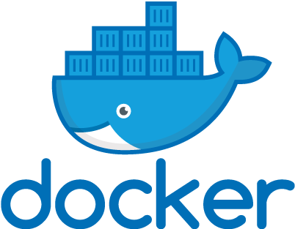
Docker Quick Start Guide
Working through the book, chapter by chapter
Earl Waud

Slide 2
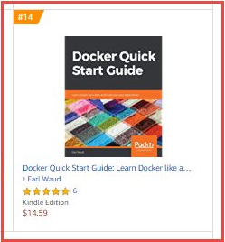
reasons you might want to use this book to learn Docker
Docker Quick Start Guide reached #14 on the Top 100 Paid best sellers list in the System Administration category.
It currently has a 4.2 out of 5.0 star rating on Amazon.com
It has been my best selling book, selling about 2000 print and kindle copies worldwide so far
And… You can SSO into Oreilly and click the following link for access to the full book FOR FREE: https://learning.oreilly.com/library/view/docker-quick-start/9781789347326/toc.xhtml

Slide 3
Today…
Chapter 1: Setting up a Docker Development Environment
Chapter 2: Learning Docker Commands
Chapter 3: Creating Docker Images
Chapter 4: Docker Volumes
Chapter 5: Docker Swarm
Chapter 6: Docker Networking
Chapter 7: Docker Stacks
Chapter 8: Docker and Jenkins

Slide 4
What we will cover today
What is a Docker network?
What built-in (also known as local) Docker networks are all about
What about third-party (also known as remote) Docker networks?
How to create Docker networks
The “free” service discovery and load balancing features
The right Docker network driver to use for your needs

Slide 5

Fun Fact
Approximately 97% of all shipping containers are manufactured in China. It is far easier to produce the container close to the shipment than to re-position containers around the
world.
https://www.billiebox.co.uk/

Slide 6
Technical requirements
You will be pulling Docker images from Docker's public repo, and installing network drivers from Weave, so basic internet access is required to execute the examples within this chapter.
Also, we will be using the jq software package, so if you haven't installed it yet, please see the instructions on how to do so - they can be found in The container inspect command section of Chapter 2, Learning Docker Commands…
The code files of this chapter in the book can be found on GitHub:
https://github.com/PacktPublishing/Docker-Quick-Start-Guide/tree/master/Chapter06
Check out the following video to see the code in action: http://bit.ly/2FJ2iBK

Slide 7
What is a docker network?
As you already know, a network is a linkage system that allows computers and other hardware devices to communicate.
A Docker network is the same thing. It is a linkage system that allows Docker containers to communicate with each other on the same Docker host, or with containers, computers, and hardware outside of the container's host, including containers running on other Docker hosts.

Slide 8
The container network model (cnm)
Docker networks allow you to manage resources at scale. They abstract away most of the complexity of networking, delivering easy-tounderstand, easy-to-document, and easy-to-use networks for your containerized apps. The Docker network is based on a standard, created by Docker, called the Container Network Model (CNM).
There is a competing networking standard, created by CoreOS, called the Container Network Interface (CNI). The CNI standard has been adopted by several projects, most notably Kubernetes, and arguments can be made to support its use.
However, in this session, we will focus our attention on the CNM standard from Docker.

Slide 9
the libnetwork project
The CNM was implemented by the libnetwork project. The CNM implementation, written in Go, is made up of three constructs: the sandbox, the endpoint, and the network.
The sandbox is a network namespace. Each container has its own sandbox. It holds the configuration of the container's network stack. This includes its routing tables, interfaces, and DNS settings for IP and MAC addresses. The sandbox also contains the network endpoints for the container.
The endpoints are what join the sandbox to networks. Endpoints are essentially network interfaces, such as eth0. A container's sandbox may have more than one endpoint, but each endpoint will connect to only a single network.
The network is a collection of connected endpoints, which allow communication between connections. Every network has a name, an address space, an ID, and a network type.

Slide 10
Network drivers
Libnetwork is a pluggable architecture that allows network drivers to implement the specifics for the components we just described. Each network type has its own network driver.
Docker provides built-in drivers. These default, or local drivers include the bridge driver and the overlay driver.
In addition to the built-in drivers, libnetwork supports third party-created drivers. These drivers are referred to as remote drivers. Some examples of remote drivers include Calico, Contiv, and Weave.

Slide 11
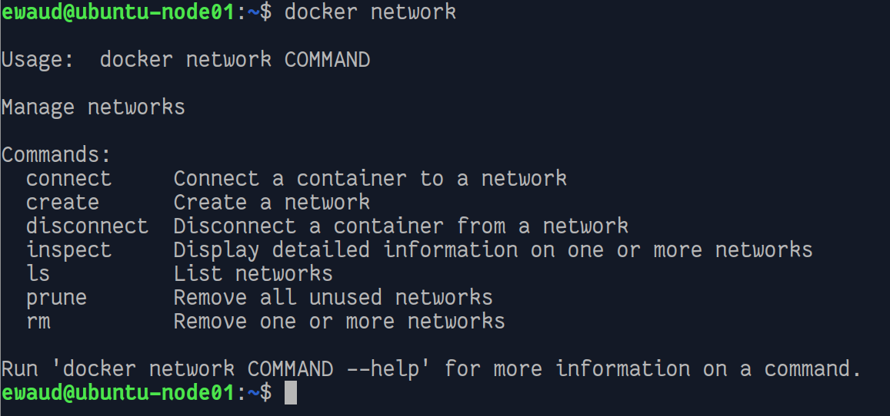
The Network Management commands

Slide 12
Built-in (local) Docker networks
The out-of-the-box install of Docker includes a few built-in network drivers, also known as local drivers. The two most commonly used drivers are the bridge network driver and the overlay network driver.
Other built-in drivers include none, host, and MACVLAN.
Without you creating any networks, your fresh Docker install will have a few networks pre-created and ready to use.
Using the network ls command, we can easily see the list of pre-created networks available in the fresh installation

Slide 13
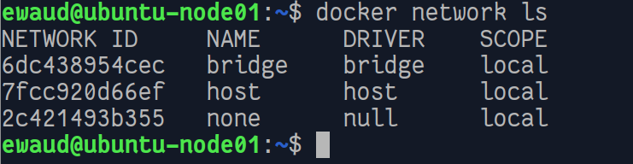
Pre-created networks
In this list, you will notice that each network has its unique network ID, a name, a driver used to create it (and that controls it), and a network scope.
Don't confuse a scope of local with the category of driver, which is also local. The local category is used to differentiate the driver's origin from third-party drivers that have a category of remote.
A scope value of local indicates that the limit of communication for the network is bound to within the local Docker host.
To clarify, if two Docker hosts, Node1 and Node2, both contain a network that has the scope of local, containers on Node1 will never be able to communicate directly with containers on Node2, even if they use the same driver and the networks have the same name.
The other network scope value is swarm, which we'll talk more about shortly.

Slide 14
Pre-created networks are different
The pre-created networks that are found in all deployments of Docker are special in that they cannot be removed.
It is not necessary to attach containers to any of them, but attempts to remove the networks with the docker network rm command will always result in an error.

Slide 15
The host network driver
There are three built-in network drivers that have a scope of local: bridge, host, and none.
The host network driver leverages the networking stack of the Docker host, essentially bypassing the networking of Docker.
All containers on the host network are able to communicate with each other through the host's interfaces.
A significant limitation to using the host network driver is that each port can only be used by a single container. That is, for example, you cannot run two nginx containers that are both bound to port 80.
As you may have guessed because the host driver leverages the network of the host it is running on, each Docker host can only have one network using the host driver:

Slide 16
The none network driver
Next there is the null or none network.
Using the null network driver creates a network that when a container is connected to it provides a full network stack but does not configure any interfaces within the container.
This renders the container completely isolated.
This driver is provided mainly for backward-compatibility purposes, and like the host driver, only one network of the null type can be created on a Docker host

Slide 17
The bridge network driver
The third network driver with a scope of local is the bridge driver.
Bridge networks are the most common type. Any containers attached to the same bridge network are able to communicate with one another.
A Docker host can have more than one network created with the bridge driver. However, containers attached to one bridge network are unable to communicate with containers on a different bridge network, even if the networks are on the same Docker host.
Note that there are slight feature differences between the built-in bridge network and any user-created bridge networks. It is best practice to create your own bridge networks and utilize them instead of the using the built-in bridge network.

Slide 18
Networks with swarm scope
In addition to the drivers that create networks with local scope, there are built-in network drivers that create networks with swarm scope.
Such networks will span all the hosts in a swarm and allow containers attached to them to communicate in spite of running on different Docker hosts.
Networks that have swarm scope requires Docker swarm mode. In fact, when you initialize a Docker host into swarm mode, a special new network is created for you that has swarm scope. This swarm scope network is named ingress and is created using the built-in overlay driver. This network is vital to the load balancing feature of swarm mode that saw used in the session on Docker Swarm.
There's also a new bridge network created in the swarm init, named docker_gwbridge. This network is used by swarm to communicate outward, kind of like a default gateway.

Slide 19
The overlay network driver
Using the overlay driver allows you to create networks that span Docker hosts.
These are layer 2 networks. There is a lot of network plumbing that gets laid down behind the scenes when you create an overlay network. Each host in the swarm gets a network sandbox with a network stack. Within that sandbox, a bridge is created and named br0. Then, a VXLAN tunnel endpoint is created and attached to bridge br0.
Once all of the swarm hosts have the tunnel endpoint created, a VXLAN tunnel is created that connects all of the endpoints together. This tunnel is actually what we see as the overlay network.
When containers are attached to the overlay network, they get an IP address assigned from the overlay's subnet, and all communications between containers on that network are carried out via the overlay.
Of course, behind the scenes that communication traffic is passing through the VXLAN endpoints, going across the Docker hosts network, and any routers connecting the host to the networks of the other Docker hosts. But, you never have to worry about all the behind the scenes stuff. Just create an overlay network, attach your containers to it, and you're golden.

Slide 20
THE macvlan network driver
The next local network driver that we're going to discuss is called MACVLAN. This driver creates networks that allow containers to each have their own IP and MAC addresses, and to be attached to a non-Docker network. What that means is that in addition to the container-to-container communication you get with bridge and overlay networks, with MACVLAN networks you also are able to connect with VLANs, VMs, and other physical servers.
Said another way, the MACVLAN driver allows you to get your containers onto existing networks and VLANs. A MACVLAN network has to be created on each Docker host where you will run containers that need to connect to your existing networks.

Slide 21
Macvlan considerations
Note that you will need a different MACVLAN network created for each VLAN you want containers to connect to. While using MACVLAN networks sounds like the way to go, there are two important challenges to using it. First, you have to be very careful about the subnet ranges you assign to the MACVLAN network. Containers will be assigned IPs from your range without any consideration of the IPs in use elsewhere. If you have a DHCP system handing out IPs that overlap with the range you gave to the MACVLAN driver, it can easily cause duplicate IP scenarios. The second challenge is that MACVLAN networks require your network cards to be configured in promiscuous mode. This is usually frowned upon in on-premise networks but is pretty much forbidden in cloud-provider networks such as AWS and Azure, so the MACVLAN driver will have very limited use cases.

Slide 22
Third-party (remote) network drivers
In addition to the built-in, or local, network drivers provided by Docker, the CNM supports community- and vendor created network drivers. Some examples of these third-party drivers include Contiv, Kuryr, and Weave.
One of the benefits of using one of these third-party drivers is that they fully support deployment in cloud-hosted environments, such as AWS. In order to use these drivers, they need to be installed in a separate installation step for each of your Docker hosts.
Each of the third-party network drivers brings their own set of features to the table. Here is the summary description of these drivers as shared by Docker in the reference architecture document …

Slide 23
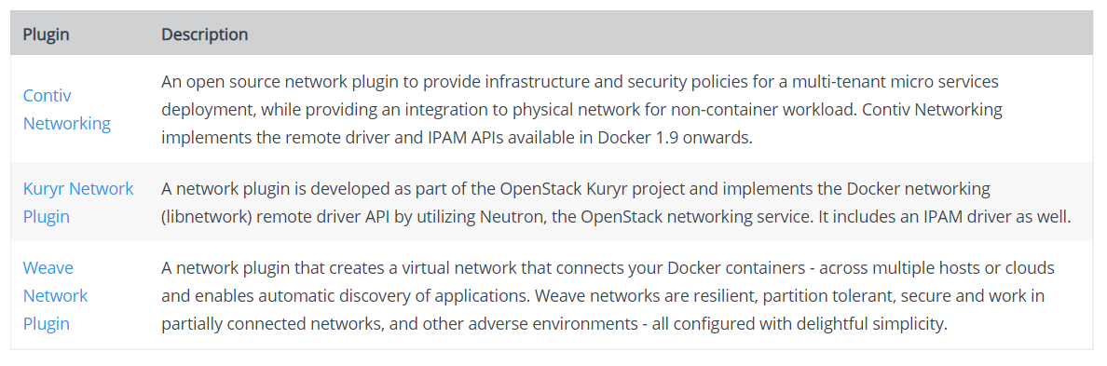
third-party network drivers summary

Slide 24
Installing third-party network drivers
Although each of these third-party drivers has its own unique installation, setup, and execution methods, the general steps are similar. First, you download the driver, then you handle any configuration setup, and finally you run the driver.
These remote drivers typically do not require swarm mode and can be used with or without it.

Slide 25
installing the weave network driver
issue the following commands on each Docker host:
# Install the weave network driver plug-in
sudo curl -L git.io/weave -o /usr/local/bin/weave
sudo chmod a+x /usr/local/bin/weave
# Disable checking for new versions
export CHECKPOINT_DISABLE=1
# Start up the weave network
weave launch [for 2nd, 3rd, etc. optional hostname or IP of 1st Docker host running weave]
# Set up the environment to use weave
eval $(weave env)
The preceding steps need to be completed on each Docker host that will be used to run containers that will communicate with each other over the weave network.

Slide 26
Adding more nodes to the weave network
if you have set up node01 with the weave network when you start up weave on node02, you would use the following command:
# Start up weave on the 2nd node
weave launch node01
Alternatively, you can connect new (Docker host) peers using the connect command, executing it from the first host configured. To add node02 (after it has weave installed and running), use the following command:
# Peer host node02 with the weave network by connecting from node01
weave connect node02
You can utilize the weave network driver without enabling swarm mode on your hosts. Once weave has been installed and started, and the peers (other Docker hosts) have been connected, your containers will automatically utilize the weave network and be able to communicate with each other regardless of whether they are on the same Docker host or different ones.

Slide 27
An Example – part 1 – setup weave network
# On ubuntu-node01, install and setup the weave driver
sudo curl -L git.io/weave -o /usr/local/bin/weave
sudo chmod a+x /usr/local/bin/weave
export CHECKPOINT_DISABLE=1
weave launch
eval $(weave env)
# On ubuntu-node02, install and setup the weave driver
sudo curl -L git.io/weave -o /usr/local/bin/weave
sudo chmod a+x /usr/local/bin/weave
export CHECKPOINT_DISABLE=1
weave launch
eval $(weave env)
# Now, back on ubuntu-node01, bring node02 in as a peer on node01's weave network
weave connect ubuntu-node02

Slide 28
An Example – part 2 – USE weave network
Launch a container on each node, making sure we name them for easy identification
# Run a container detached on ubuntu-node01
docker container run -d --name app01 alpine tail -f /dev/null
# Run a container detached on ubuntu-node02
docker container run -d --name app02 alpine tail -f /dev/null

Slide 29
An Example – part 2 – continued
Now, we have containers running on both nodes. Let's see whether they can communicate. Since we are on node02, we will check there first
# From inside the app02 container running on ubuntu-node02, let's ping the app01 container running on ubuntu-node01
docker container exec -it app02 ping -c 4 app01
Let's try going the other way…
# Similarly, from inside the app01 container running on ubuntu-node01, let's ping the app02 container running on ubuntu-node02
docker container exec -it app01 ping -c 4 app02
We have bi-directional communication. Did you notice anything else? We have name resolution for our app containers (we didn't have to ping by IP only).

Slide 30
Creating Docker networks
OK, you now know a lot about both the local and the remote network drivers, and you have seen how several of them are created for you when you install Docker and/or initialize swarm mode (or install a remote driver).
But, what if you want to create your own networks using some of these drivers? It is really pretty simple.
# Create a new overlay network, with all default options
docker network create -d overlay defaults-over

Slide 31
Creating a network with more options
# Create a new overlay network with specific IP settings
docker network create -d overlay \
--subnet=172.30.0.0/24 \
--ip-range=172.30.0.0/28 \
--gateway=172.30.0.254 \
specifics-over
# Initial validation check (sudo apt-get install jq)
docker network inspect specifics-over --format '{{json .IPAM.Config}}' | jq

Slide 32
Using the newly created network
# Create a service that uses the new network
docker service create --quiet --replicas 3 --name tester1 \
--network specifics-over alpine tail -f /dev/null
# List the containers… docker container ls
# Review the container’s networks…
docker container inspect 2tq4 --format '{{json .NetworkSettings.Networks}}' | jq
# Review the network config…
docker network inspect specifics-over --format '{{json .IPAM.Config}}' | jq

Slide 33
“Free” networking features
There are two networking features or services that you get for free with your Docker swarm networks. The first is Service Discovery, and the second is load balancing.
When you create Docker services, you get these features automatically. We experienced these features in this chapter and in the session on Docker Swarm, but didn't really refer to them by name. So, let's call them out here…

Slide 34
Service Discovery
When you create a service, it gets a unique name. That name gets registered with the swarm DNS. And, every service uses the swarm DNS for name resolution.
Here is an example for you. We are going to leverage the specifics-over overlay network we created earlier in the creating Docker networks section. We'll create two services (tester1 and tester2) attached to that network, then we will connect to a container in the tester1 services and ping the tester2 service by name.

Slide 35
Show service discovery in action
# Create service tester1
docker service create --detach --replicas 3 --name tester2 \
--network specifics-over alpine tail -f /dev/null
# Create service tester2
docker service create --detach --replicas 3 --name tester3 \
--network specifics-over alpine tail -f /dev/null
# From a container in the tester1 service ping the tester2 service by name
docker container exec -it tester2.3.5hj309poppj8jo272ks9n4k6a ping -c 3 tester3

Slide 36
Load balancing
The second free feature we get is Load balancing. This powerful feature is pretty easy to understand. It allows traffic intended for a service to be sent to any host in a swarm regardless of whether that host is running a replica of the service.
Imagine a scenario where you have a six-node swarm cluster, and a service that has only one replica deployed. You can send traffic to that service via any host in the swarm and know that it will arrive at the service's one container no matter which host the container is actually running on.
In fact, you can direct traffic to all hosts in the swarm using a load balancer, say in a round-robin model, and each time traffic is sent to the load balancer, that traffic will get delivered to the app container without fail.

Slide 37
Which Docker network driver should I use?
The short answer to that question is the right one for the job. That means there is no single network driver that is the right fit for every situation.
If you're doing work on your laptop, running with swarm inactive, and you just need your containers to be able to communicate with each other, the simple bridge mode driver is ideal.
If you have multiple nodes and just need container-to-container traffic, the overlay driver is the right one to use. This one works well in AWS, if you are within the container-to-container realm.
If you need container-to-VM or container-to-physical-server communication (and can tolerate promiscuous mode), the MACVLAN driver is the way to go.
Or, if you have a more complex requirement, one of the many remote drivers might be just what the doctor ordered. I've found that for most multi-host scenarios, the overlay driver will get the job done, so I would recommend that you enable swarm mode, and give the overlay driver a try before you ramp up to any of the other multi-host options.

Slide 38
Summary
Docker has taken a complex technology, networking, and made it easy to understand and use. Most of the crazy, difficult setup stuff is literally handled with a single swarm init command.
Let's review: you learned about the network design that Docker created, called the container network model, or CNM. Then, you learned how the libnetwork project turned that model into a pluggable architecture. After that, you found out that Docker created a powerful set of drivers to plug into the libnetwork architecture to enable a variety of network options for most of your container communication needs. Since the architecture is so pluggable, others have created even more network drivers that solve any edge cases that the Docker drivers don't handle.

Slide 39


